Slide 1

QRtick
Employee attendance and manage control using QR Codes

Slide 2
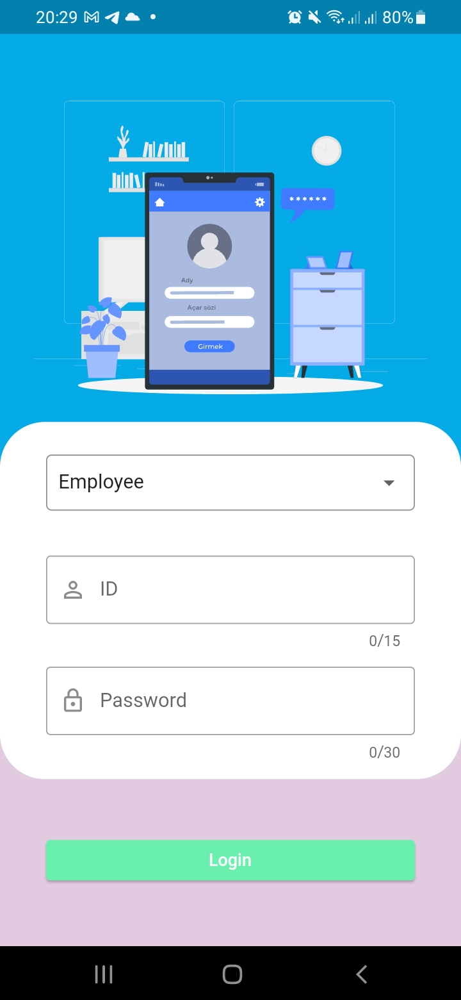
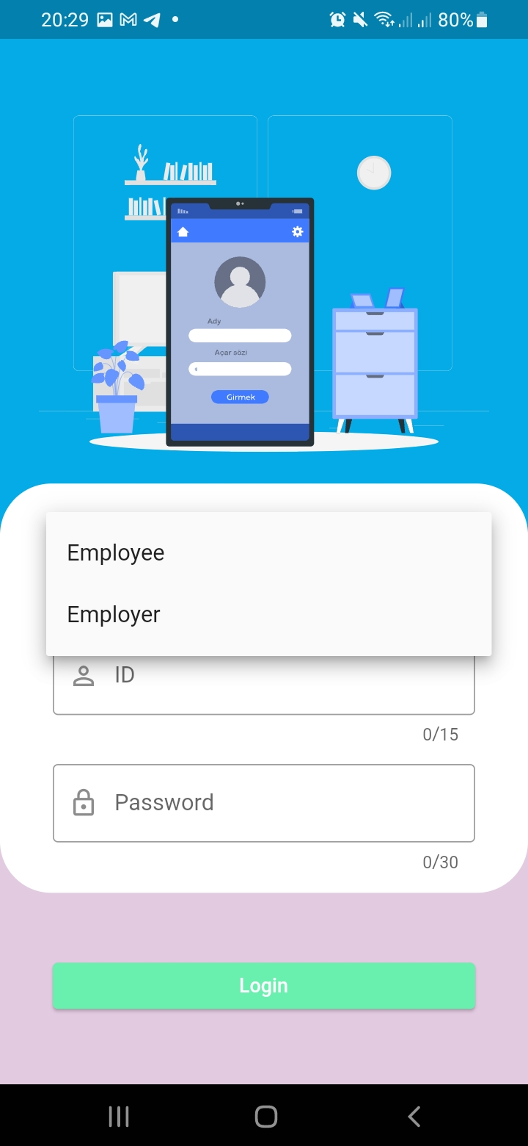
Login page
User can choose between employee and employer when logging in

Slide 3
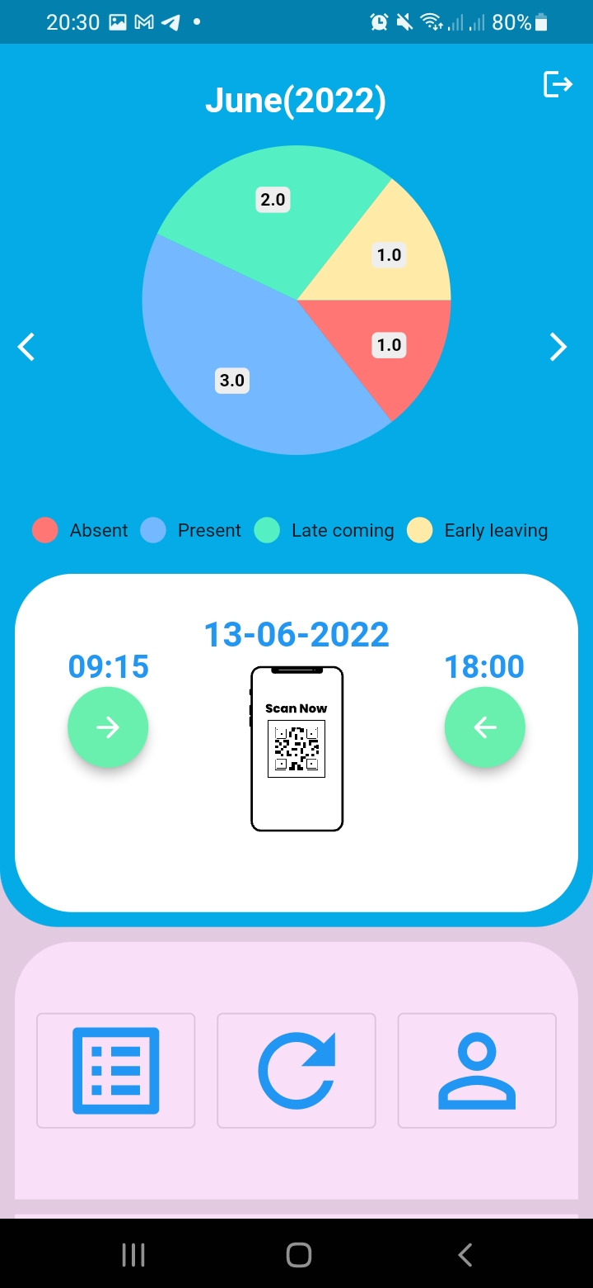
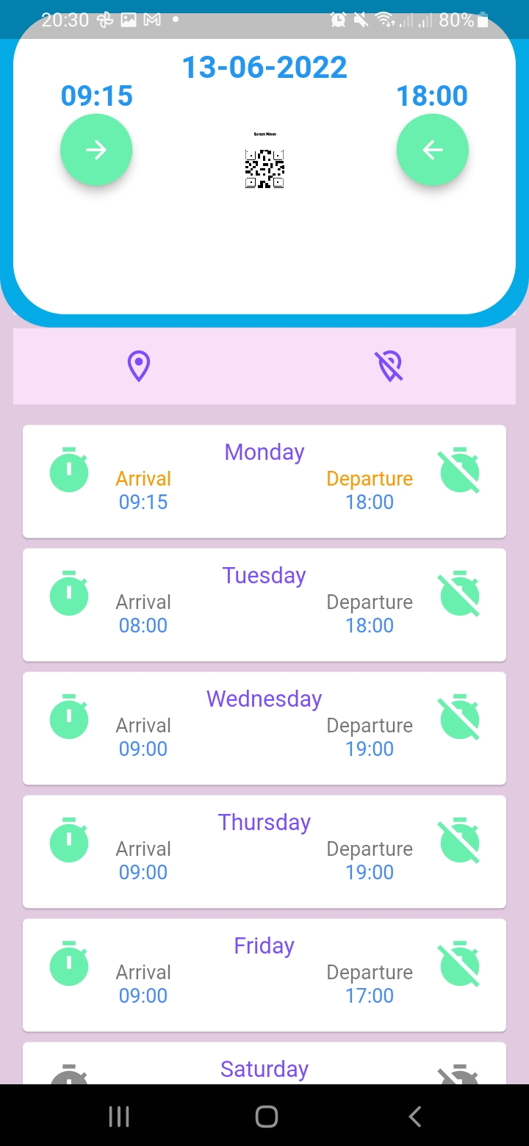
Employee home page
Employees can slide this page

Slide 4
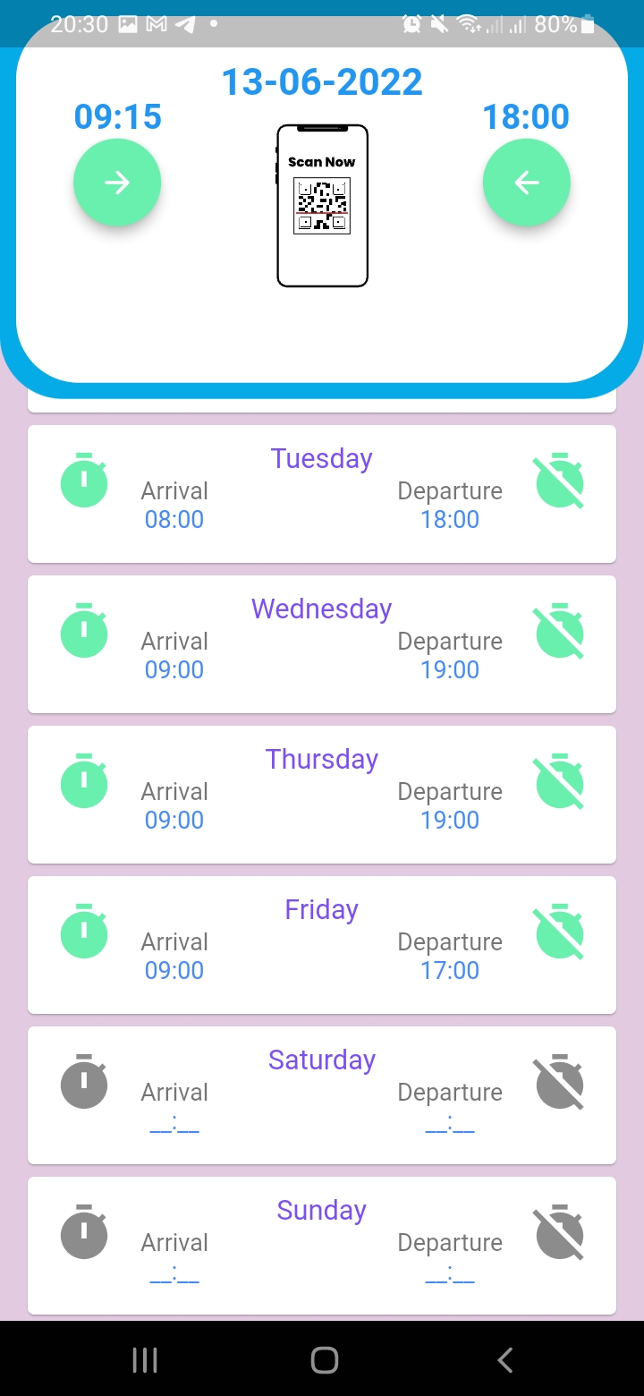
Employee home page
Employees can slide this page

Slide 5
Employee home page
Current month
This pie chart shows number of monthly attendance results, like absent, present, late coming and early leaving
Arrival and Departure times for the current day.
Button for scanning QR code when leaving the work.
Button for scanning QR code when arriving to the work.
Employees can slide this page.
Button for opening employee attendance results page
Button for refreshing employee home page
Button for opening employee profile page

Slide 6
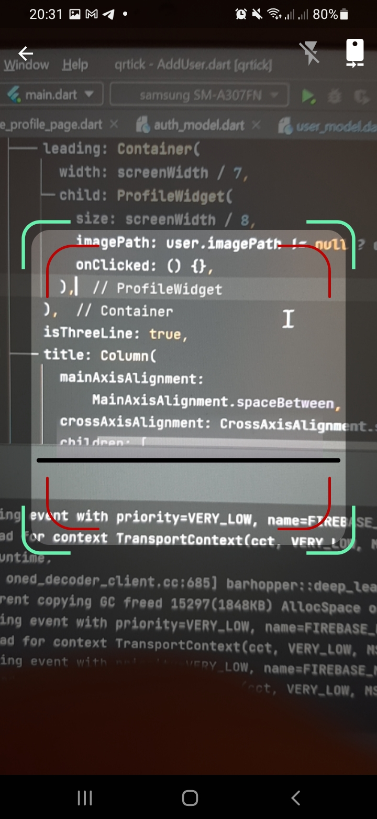
Qr code scanner page
By clicking these buttons employees can scan provided QR code in this page

Slide 7
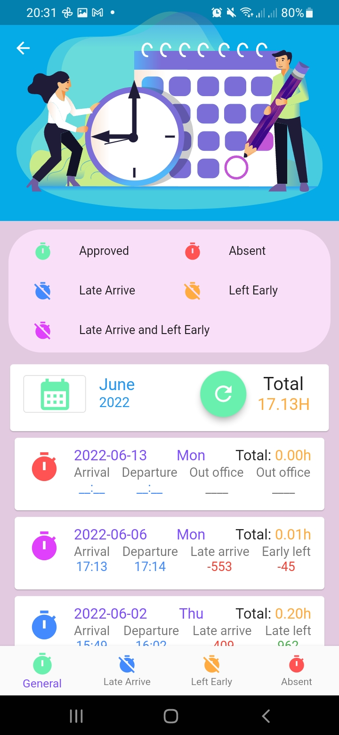
Employee attendance results page
Employees can see their monthly attendance results and total working hours

Slide 8
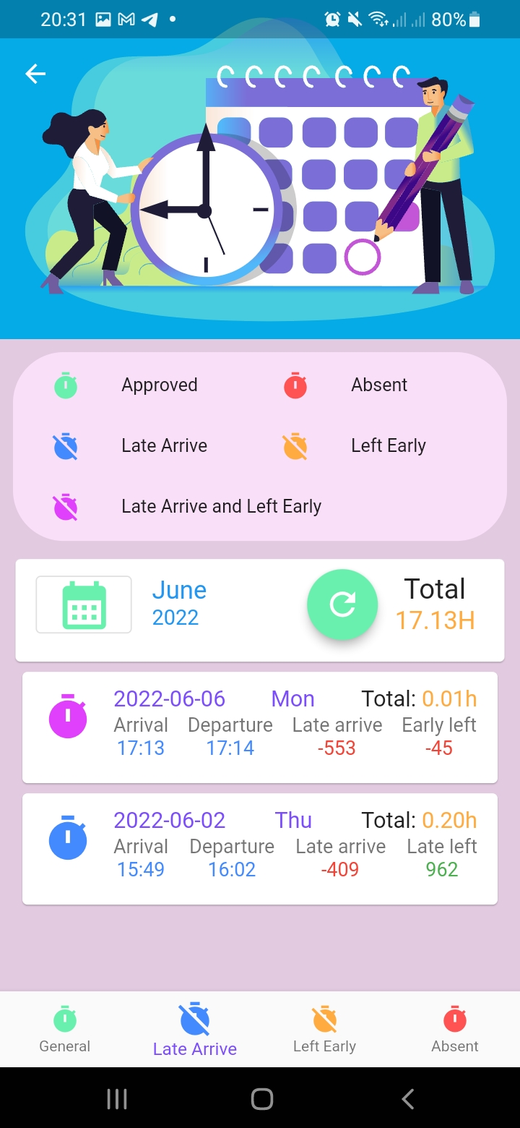
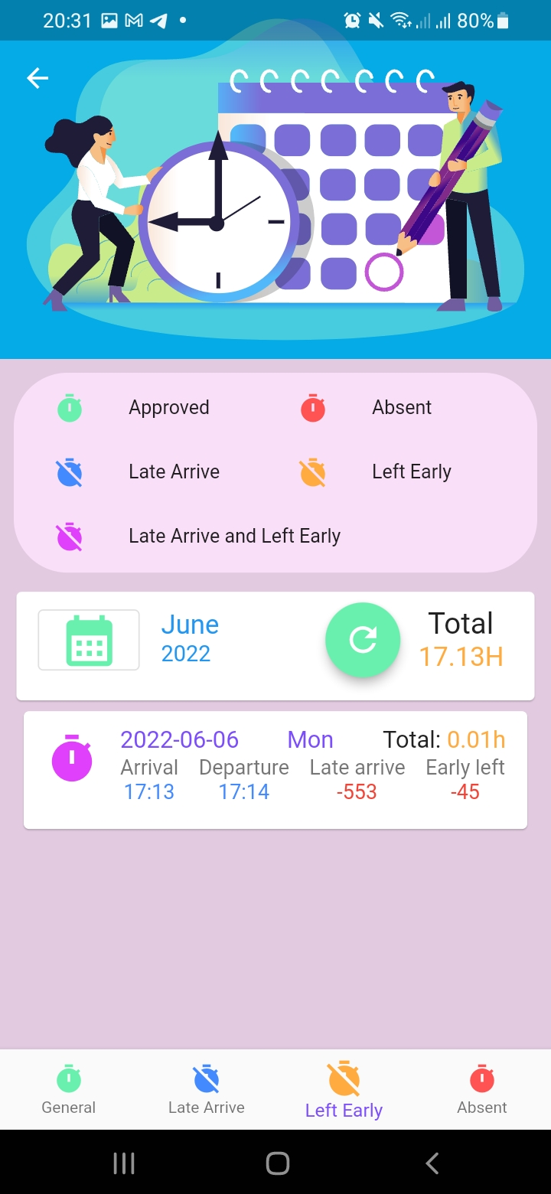
Employee attendance results page
Employees can see days when they arrived late/ left early/absent by clicking bottom navigation bar buttons

Slide 9

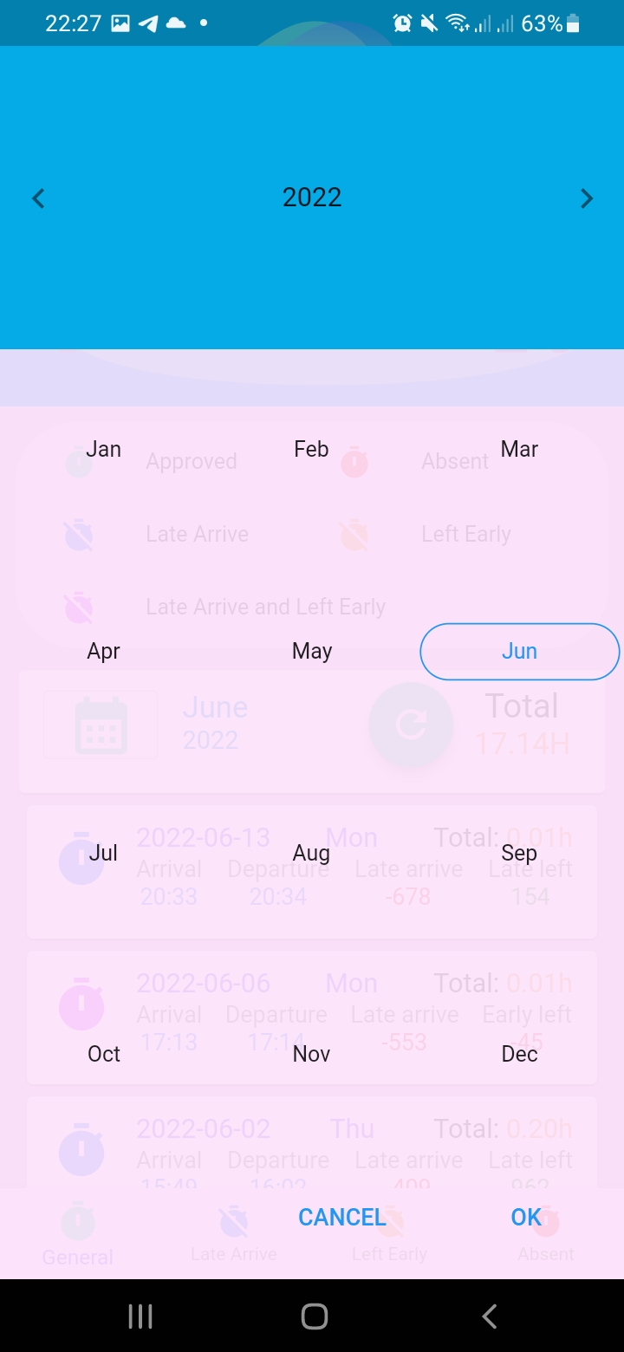
Employee attendance results page
Employees can choose which month to see by clicking button with calendar icon

Slide 10
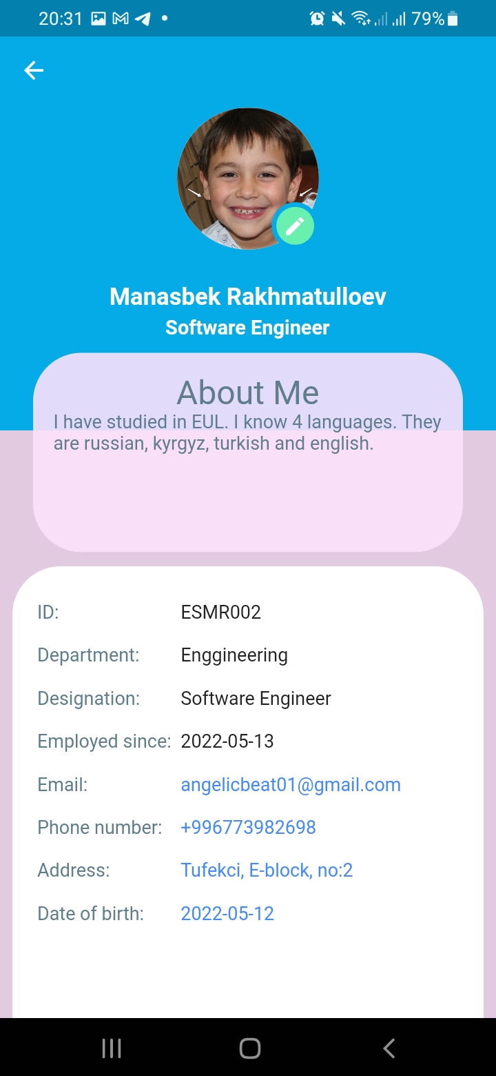
Employee Profile Page
Employees can see their profiles

Slide 11
Employee home page
Here shown weekly work schedule. Grey icons indicate off days.

Slide 12
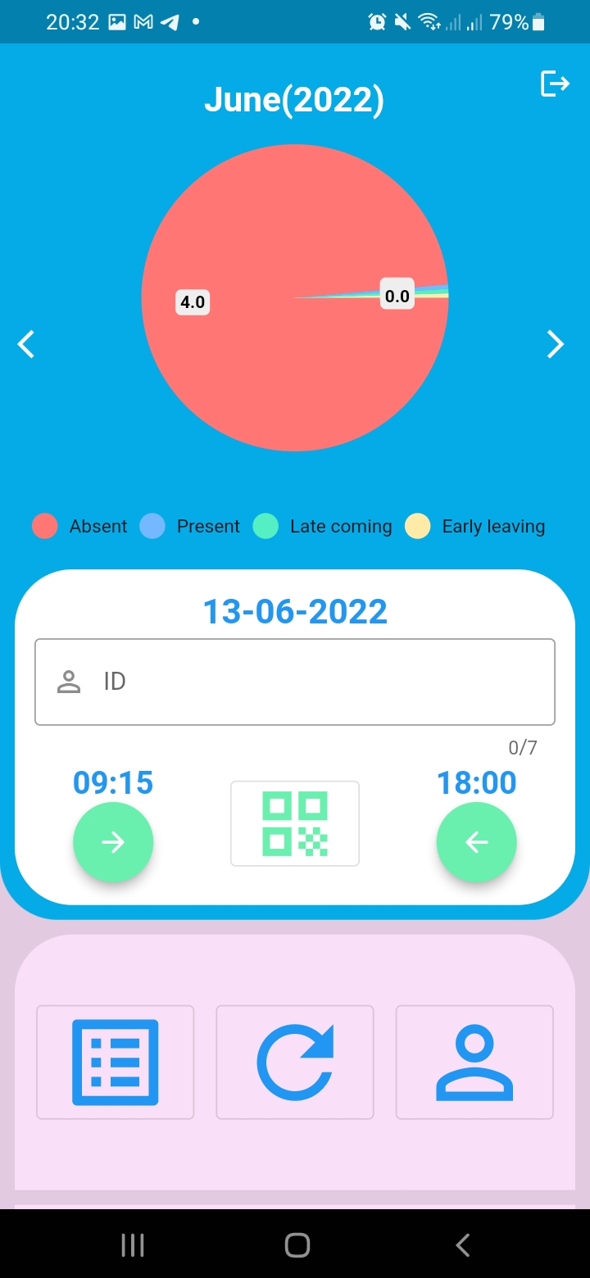
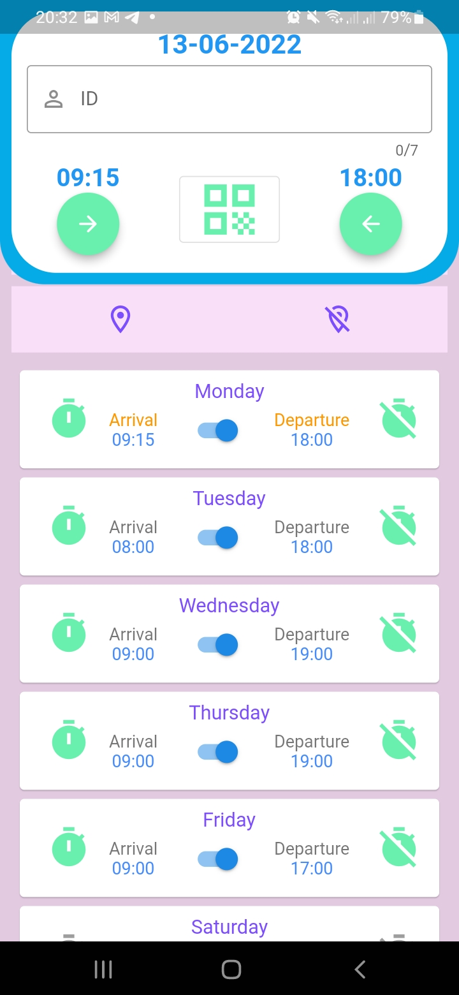
Employer home page
Employer can slide this page

Slide 13
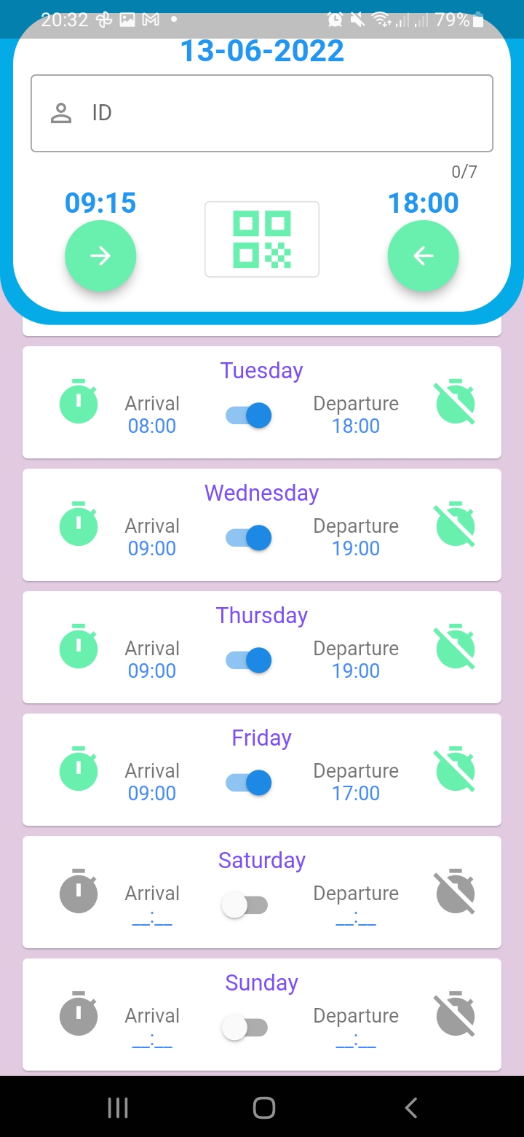
Employer home page
Employer can slide this page

Slide 14
Employer home page
This pie chart shows number of daily attendance results, like absent, present, late coming and early leaving
Arrival and Departure times for the current day.
Enter employee id for manual attendance
Button for manually marking employee when leaving the work.
Button for manually marking employee when arriving to the work.
Employer can slide this page
Button for updating QR code
Button for opening employee attendance results page
Button for refreshing employee home page
Button for opening employees’ profile pages

Slide 15
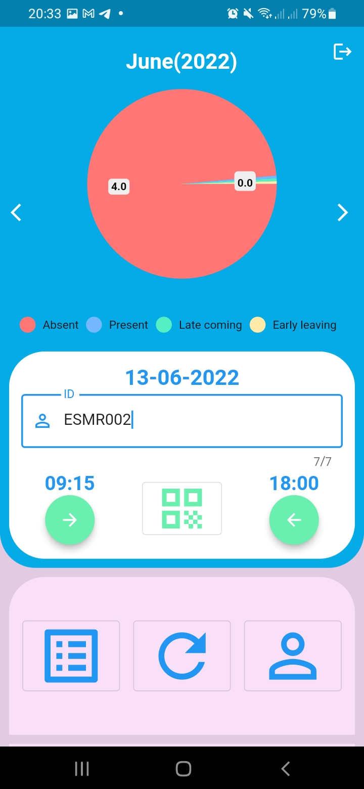
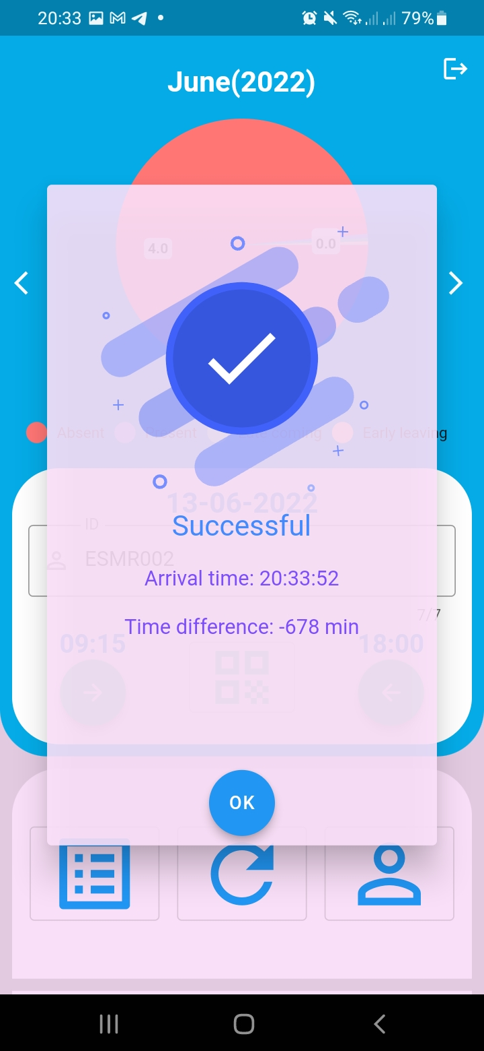
Employer home page
Employer can manually attend employees by providing their id and clicking arrival and departure buttons

Slide 16
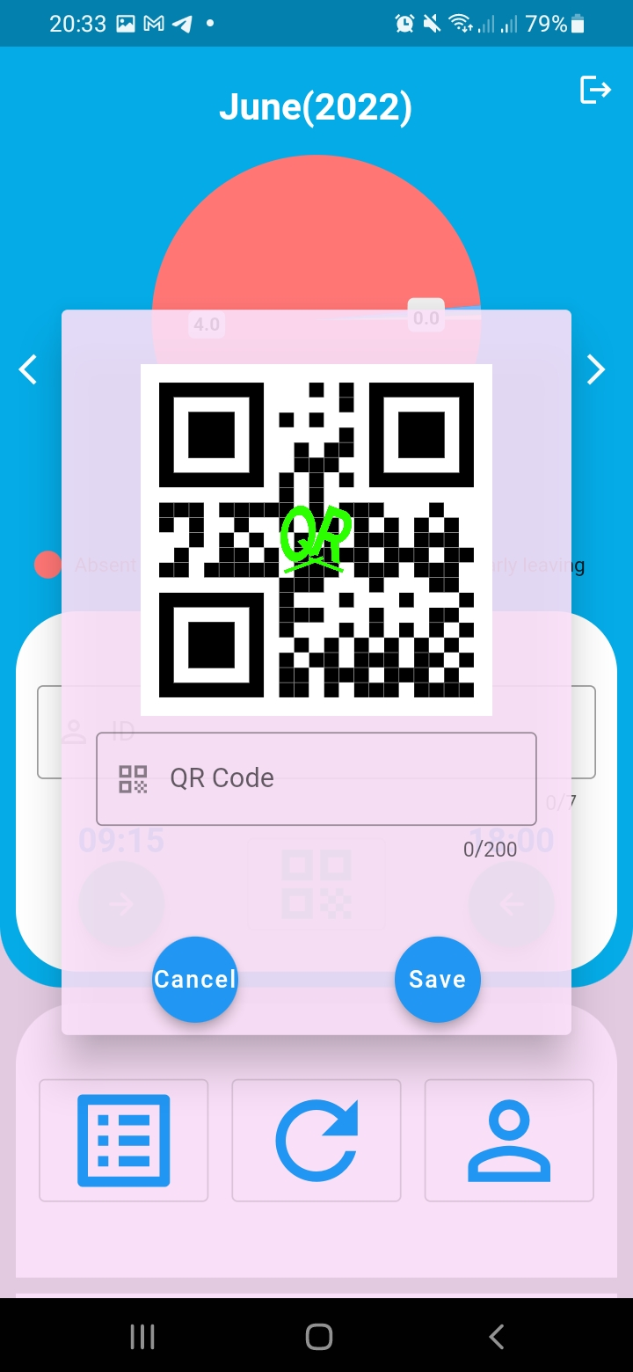
Employer home page
By clicking button with QR code icon, employer can change or update QR code

Slide 17
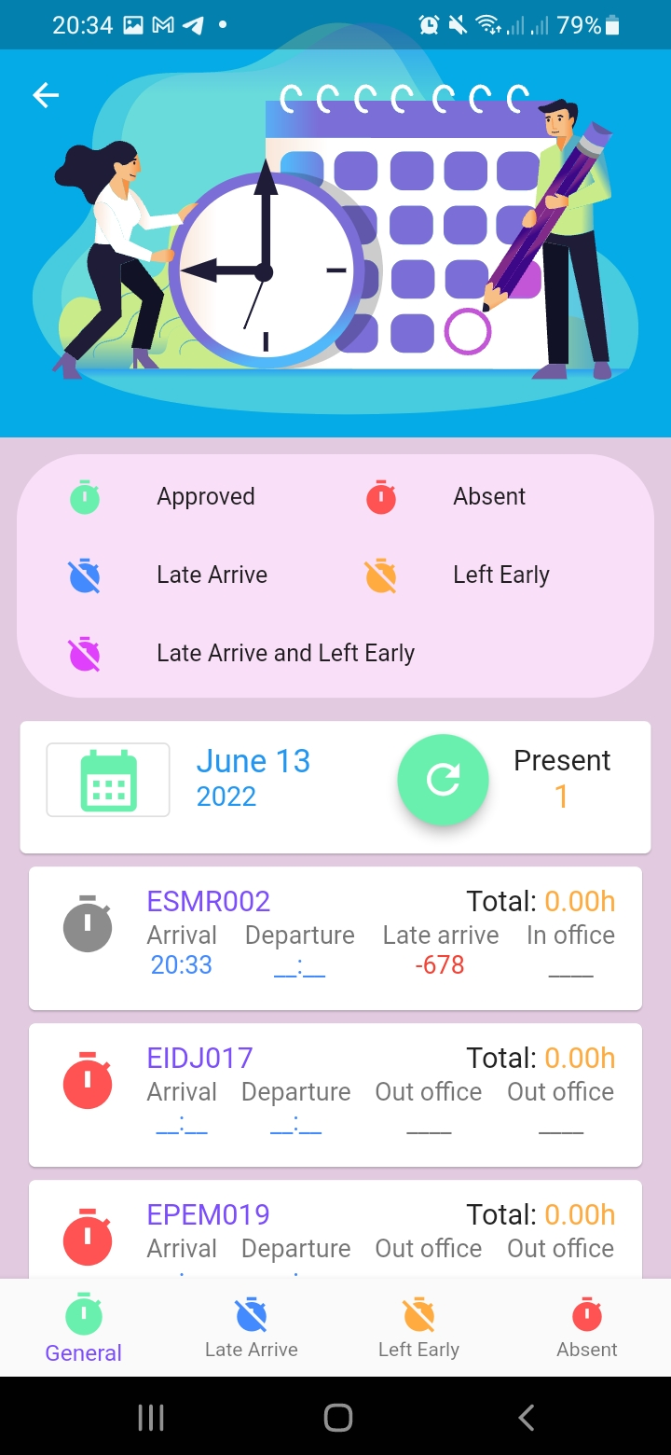
Employer attendance results page
Employers can see employees’ daily attendance results and total working hours

Slide 18

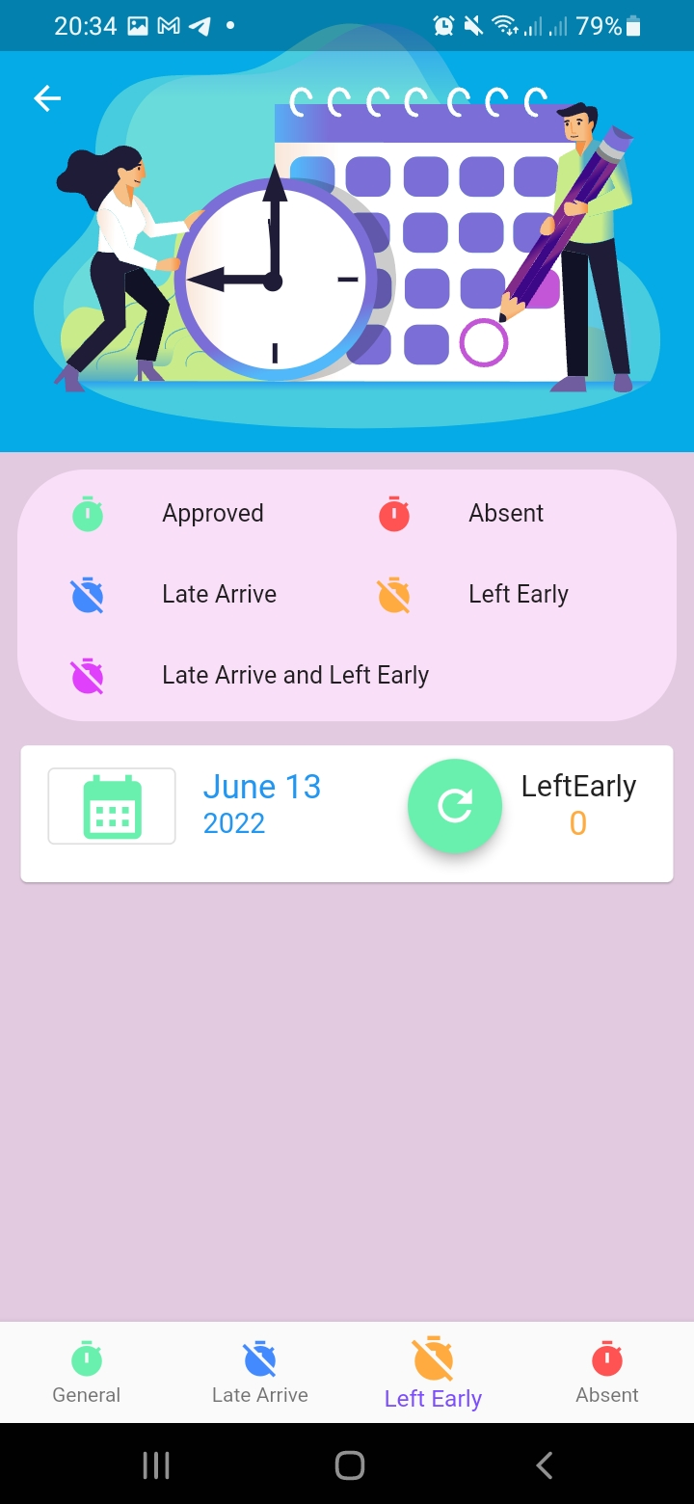
Employer attendance results page
Employers can see which employees arrived late/ left early/absent by clicking bottom navigation bar buttons

Slide 19
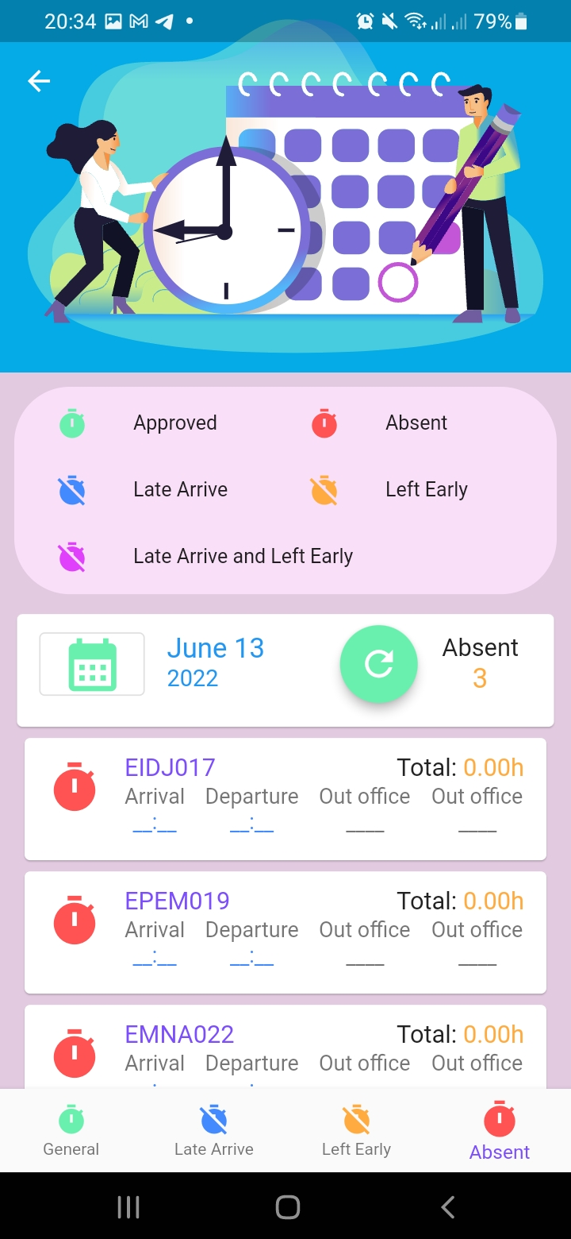
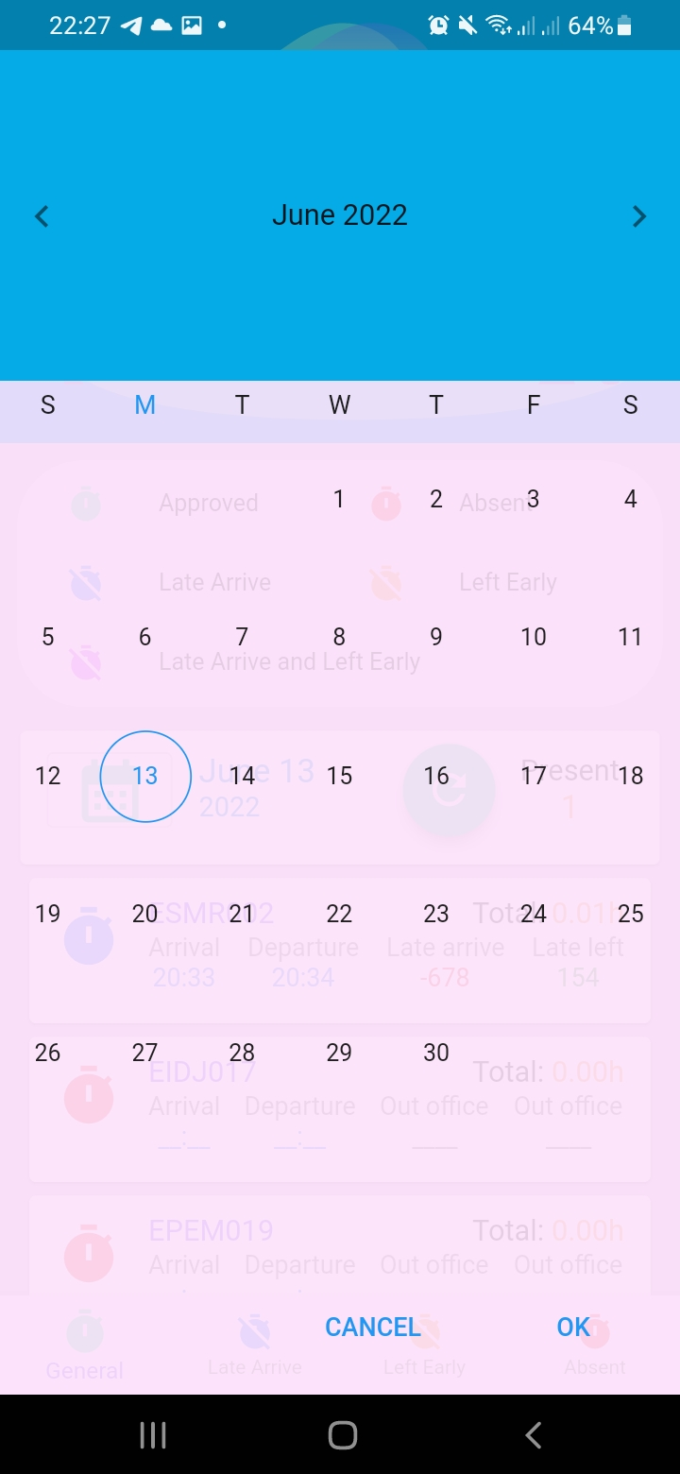
Employer attendance results page
Employers can choose which day to see by clicking button with calendar icon

Slide 20
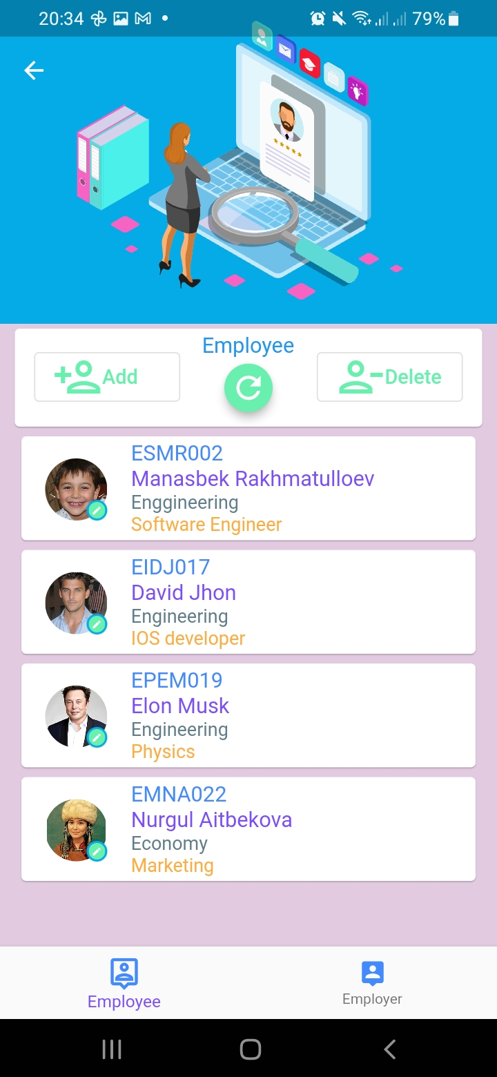
Employer Profile page
Employers can see employees’ profile pages by clicking list elements/can add new user by clicking add button./can delete users by clicking delete button

Slide 21
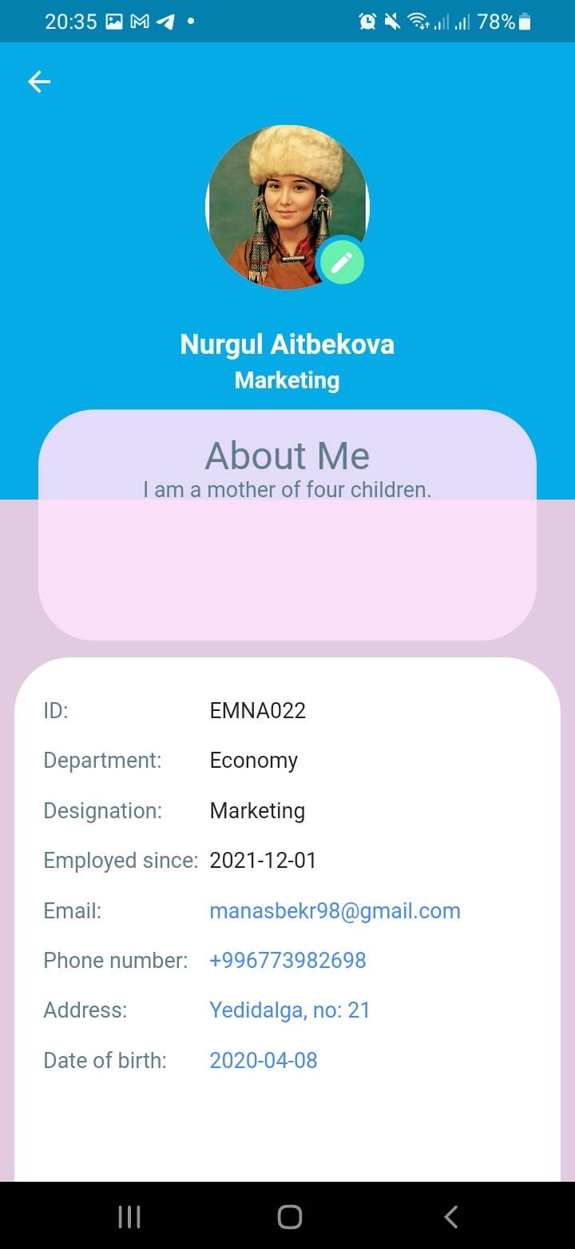
Employer Profile page
Employers can see employees’ profile pages by clicking list elements/can add new user by clicking add button./can delete users by clicking delete button

Slide 22
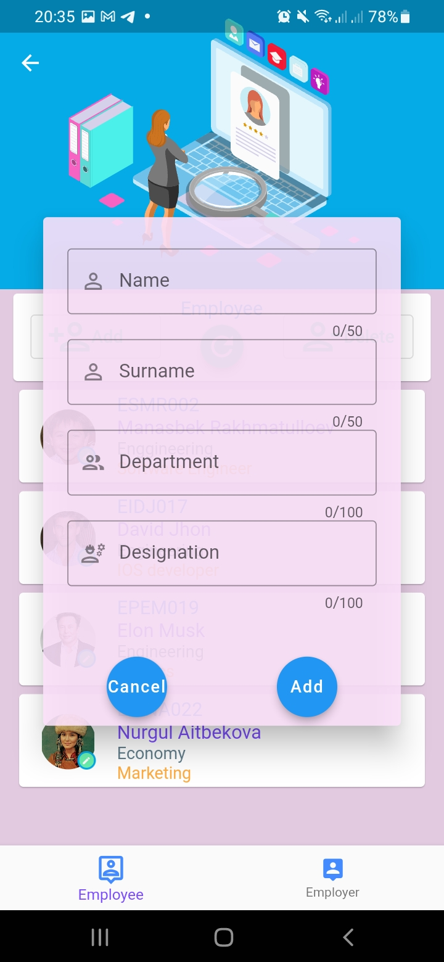
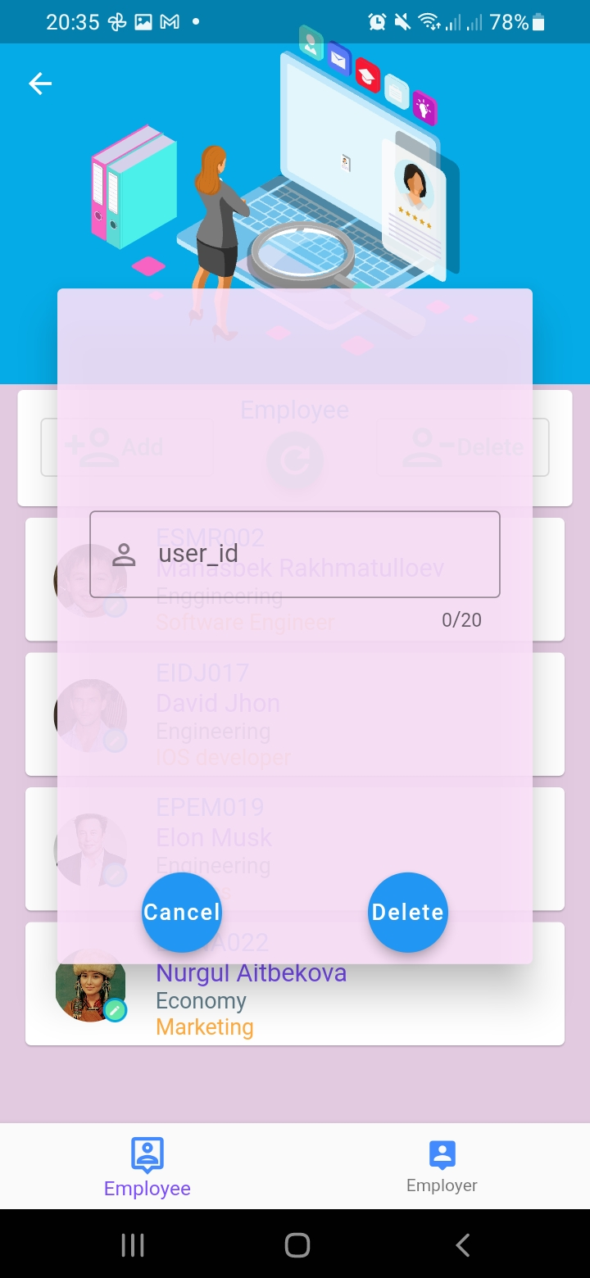
Employer Profile page
Employers can see employees’ profile pages by clicking list elements/can add new user by clicking add button./can delete users by clicking delete button

Slide 23
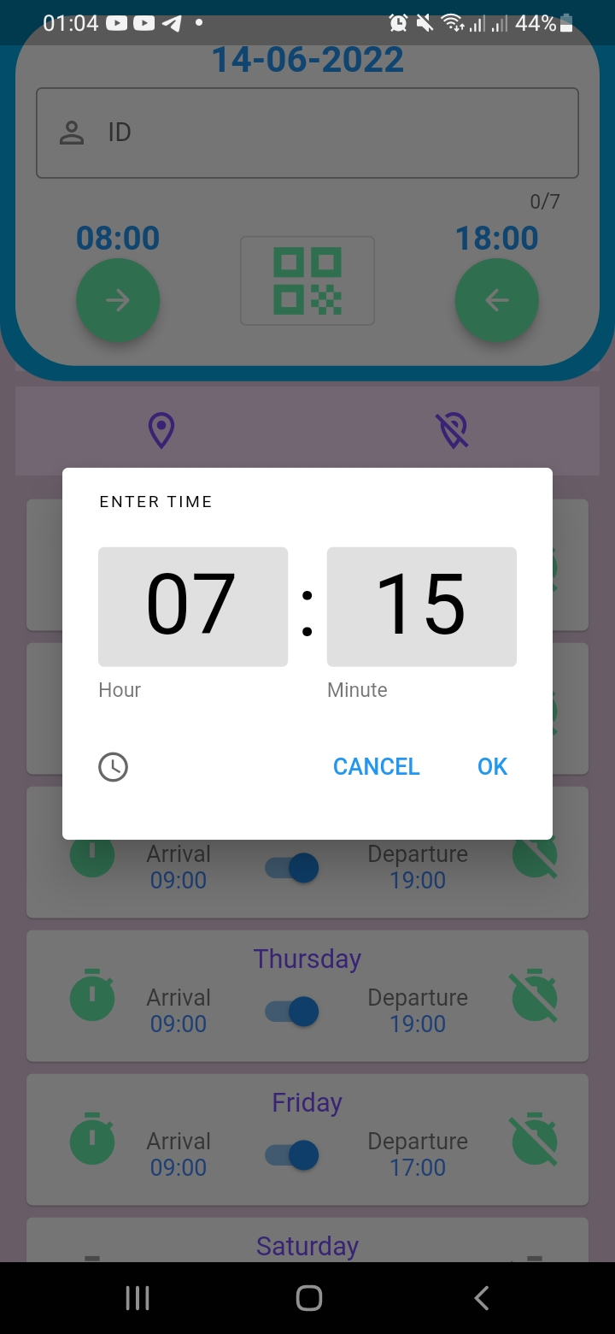
Employer home page
By clicking these buttons employers can change working schedule times and working or not working days

